Slide 1
Analyzing the Impact of Rising Cost of Living on Supply Chain & Development
Team 36
Sam Hossain
Zaheen Mahaey

Slide 2
Objective
Explore impact of
rising living costs
on supply chain
Identify
economic and regional factors
for supply chain cost increases
Provide actionable recommendations for supply chain strategies

Slide 3
Executive Summary
Rising living costs significantly impact supply chain stability, increasing production, transport, and labor costs.
Sub-Saharan Africa faces the highest inflation pressures; North America shows strong resilience.
Energy price inflation (+63.7%) is the largest driver of costs increases, with low-income regions most affected.
Predictive models highlight the need for energy stabilization, infrastructure upgrades, and trade agreements.

Slide 4
Data Methodology
Data Sources & Variables:
From one given dataset: 283
From the other set: 3 variables (Region & Income Group)
UNDP website: 2 variables (HDI Index related)
World Bank Data Bank: 20 variables (PPI & supply chain related)
Total 308 variables
Data Cleaning:
Merged datasets, grouped into 4 broad categories: Cost of Living Data, Economic Development Indicators, Supply Chain Metrics and Indices, Household Income and Expenditure Data
Dropped 150+ non-relevant columns
Performed EDA – Dropped 55 columns for >70% missing values
Dropped 20+ countries for >70% missing values
Imputed missing values by Region, Income Group and Country-based time-series interpolation and KNN methods
Data Modeling:
Transformed into Multi-index and Long Format for Panel Data Analysis
Dropped high VIF variables indicating multicollinearity
Performed Fixed Effects (FE) and Random Effects (RE) models.
Hausman tests to validate model selection.

Slide 5
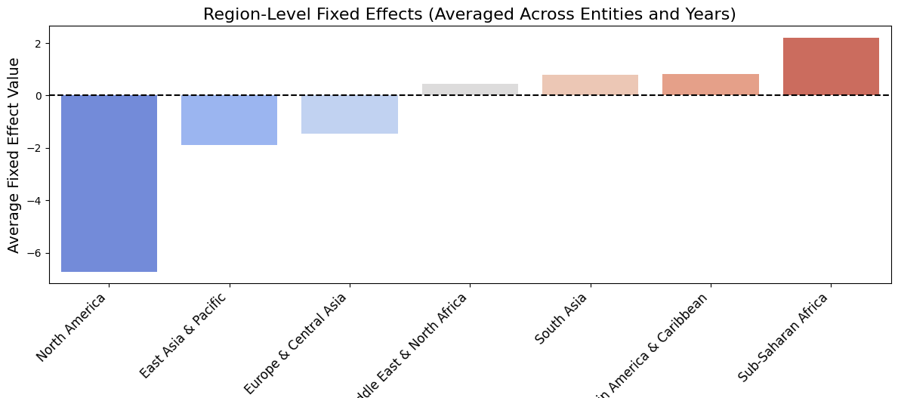
Regional Insights
North America (-6.72): Strong resilience due to advanced logistics and local production
Sub-Saharan Africa (+2.21): High inflationary pressures driven by energy costs and poor infrastructure

Slide 6
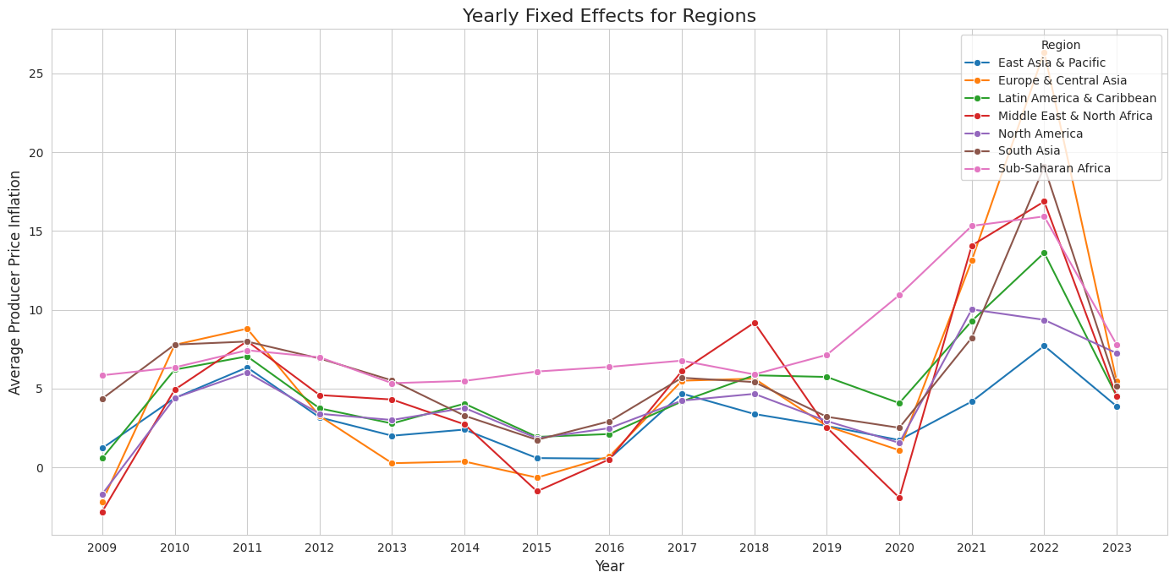
Regional Insights
Sub-Saharan Africa shows consistently high producer price inflation compared to other regions, especially post-2020, highlighting persistent economic pressures.
Regions like East Asia & Pacific and North America maintain more stable inflation trends

Slide 7
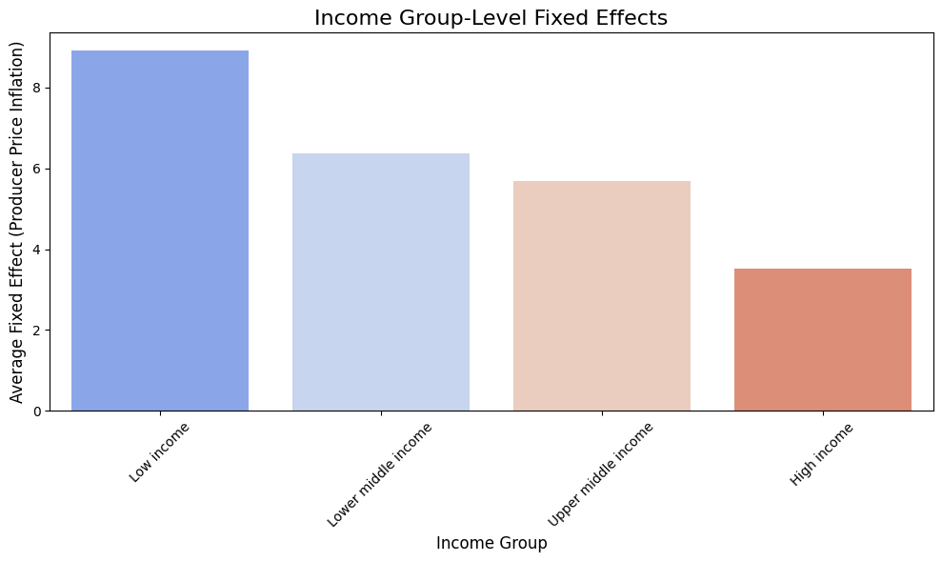
Income Group Insights
Low Income (+8.91): Highest inflationary pressure due to weak supply chains and high import dependence
High Income (+3.52): Lowest inflation due to efficient supply chains and advanced infrastructure

Slide 8
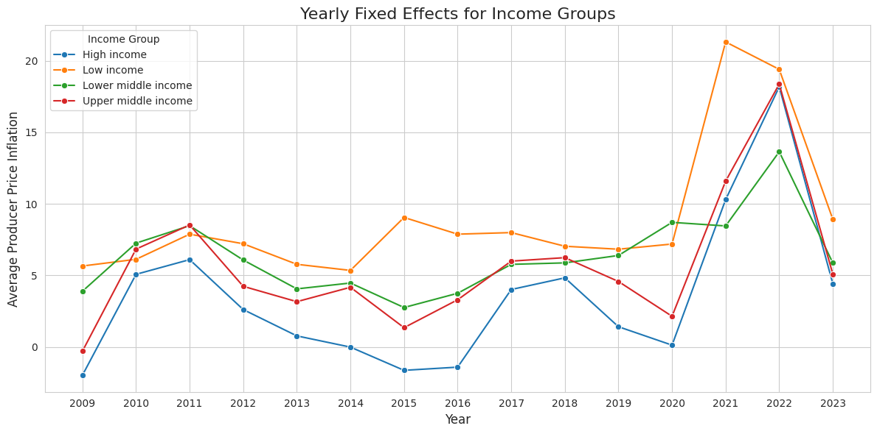
Income Group Insights
Low-income groups exhibit consistently higher producer price inflation, with peaks in 2022, reflecting increased economic vulnerability to external shocks.
High-income groups maintain relatively stable inflation, yet their prices increased too post-covid

Slide 9
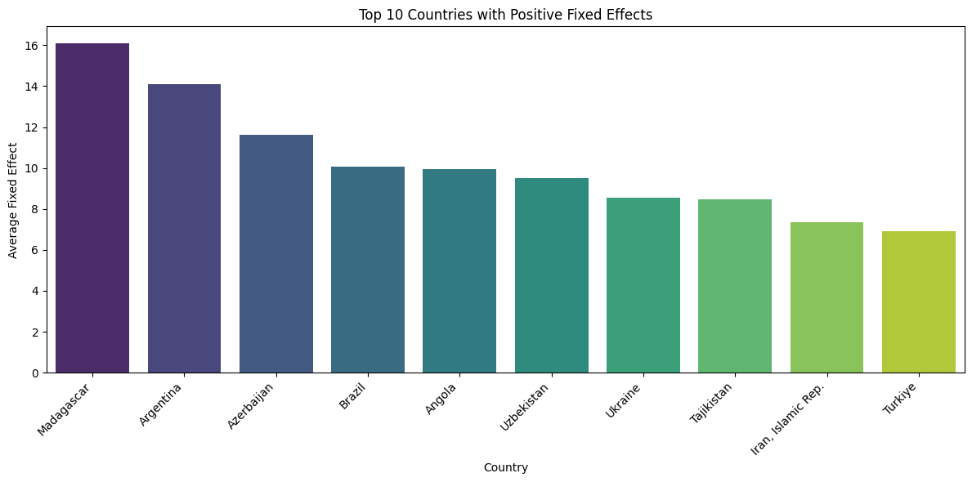
Country Insights
Madagascar (+16.11): Driven by supply chain inefficiencies and import dependency
Argentina (+14.09): Persistent inflation due to currency volatility
Brazil (+10.07), Ukraine (+8.53), Tajikistan, Uzbekistan
Challenges: High energy prices, weak logistics, and economic instability

Slide 10
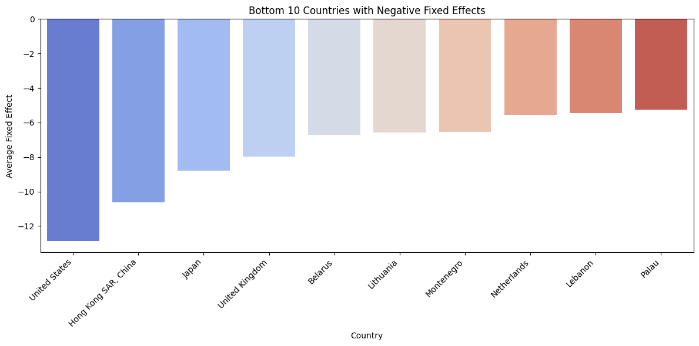
Country Insights
United States (-12.88): Strong deflationary impact due to efficient supply chains and advanced logistics
Hong Kong SAR (-10.61): Benefit from its status as a global trade hub
Japan, UK, Netherlands, Belarus, Lebanon
Strengths: Strong cost control and supply chain efficiency

Slide 11
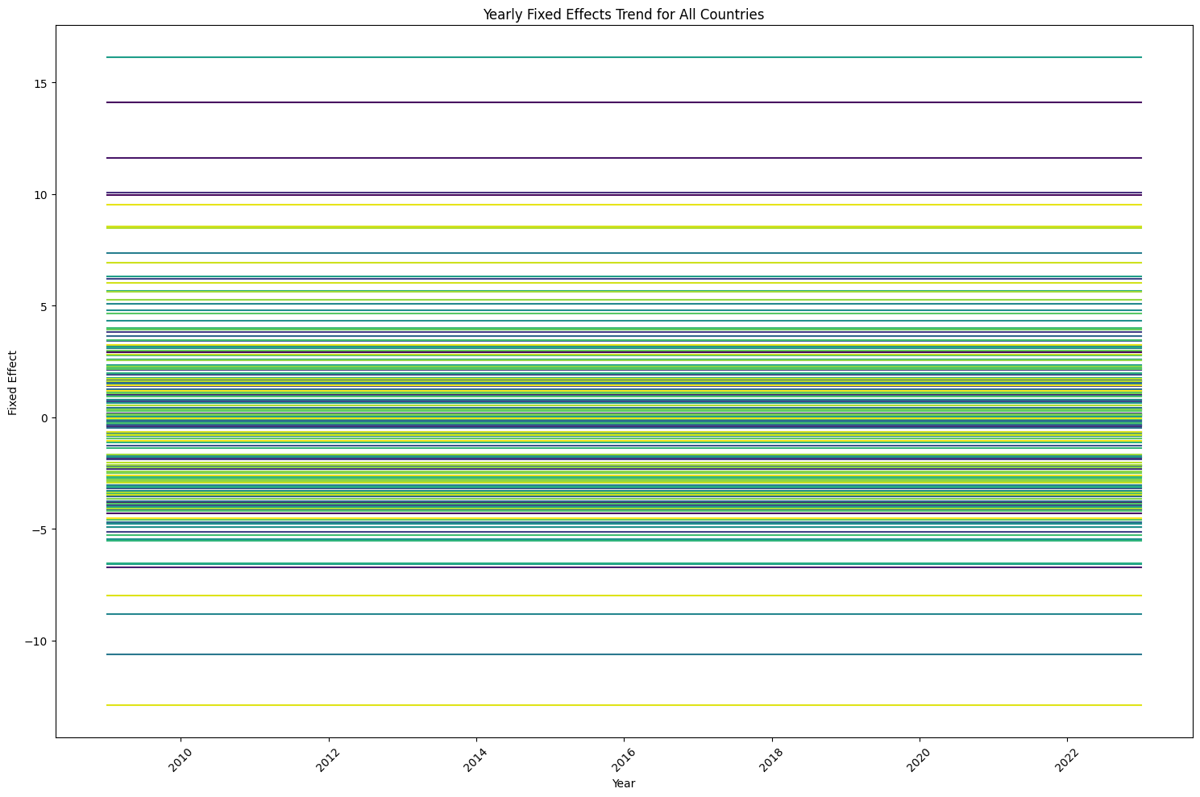
Country Insights (All)
Wide variations across countries indicate differing levels of inflation, with some consistently experiencing high or low inflation
Consistent trends for most countries suggest systemic factors influencing more than isolated shocks

Slide 12
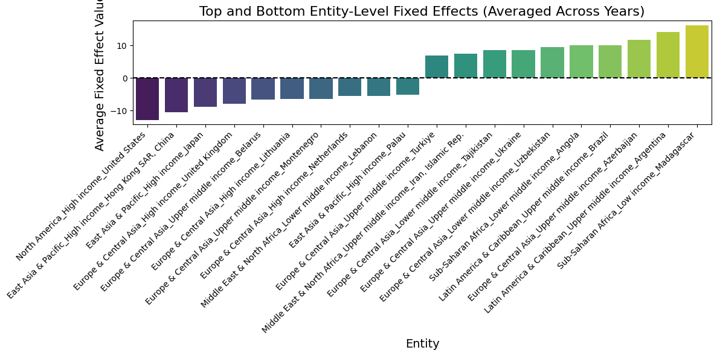
Combo Insights
The United States and Hong Kong exhibit the most negative fixed effects, indicating highly efficient supply chain
Madagascar and Argentina show the highest positive fixed effects, highlighting significant inflationary pressures and supply chain vulnerabilities

Slide 13
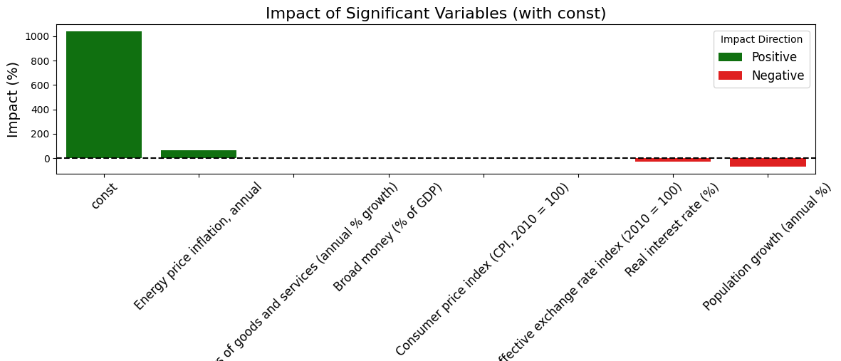
Predictive Modeling Insights
Baseline level of PPI: The constant inflation of 1040.51%, indicates a high inherent inflation rate, potentially reflective of global economic factors.
Strong Positive Drivers: Energy price inflation (+63.7%) has the largest impact on producer price inflation, Imports of goods and services (+2.76%)

Slide 14
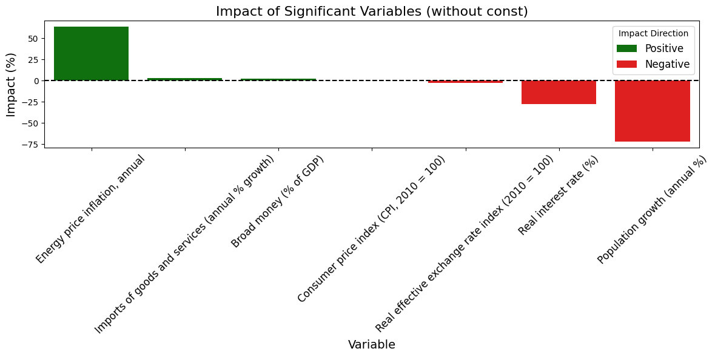
Predictive Modeling Insights
Negative Drivers (Inflation Dampeners): Real effective exchange rate (-2.73%), Real interest rate (-27.59%)
Implications for Policymakers: Focus on energy efficiency and monetary policy adjustments

Slide 15
Predictive Modeling Insights
Short Term: Focus on energy efficiency and money market intervention for immediate pressure release
Long Term: Invest in renewable energy, local industrialization and infrastructure
Variable | Impact (%) | Direction | Key Insight
Energy price inflation | 63.70 | Positive | Major driver of production cost increases.
Imports growth % | 2.76 | Positive | Dependency on imports raises inflation.
Broad money (% of GDP) | 2.32 | Positive | Higher money supply contributes to inflation.
Consumer price index (CPI) | 0.037 | Positive | Rising living costs trickle into production.
Real effective exchange rate | -2.73 | Negative | Stronger currency lowers input costs.
Real interest rate (%) | -27.59 | Negative | Higher rates reduce demand and inflation.
Population growth % | -72.13 | Negative | May reflect regional labor supply effects.

Slide 16
Strategic Recommendations
Focus: Global Regions
Use resilient regions like North America as models for supply chain efficiency.
Invest in infrastructure, logistics, and energy cost reduction in regions like Sub-Saharan Africa, South Asia, and Latin America
Stabilize oil and energy price fluctuations to control inflation in Middle East & North Africa
Share best practices globally to stabilize costs
Focus: Income Group-based Regions
High-income countries serve as benchmarks; middle-income countries should focus on local supply chains and reducing import dependencies
Low-Income countries require global support, policy reforms, and infrastructure investments

Slide 17
Strategic Recommendations
Focus: Specific Countries
Focus on infrastructure development to reduce import reliance, improve logistics, and stabilize inflation in resource-dependent nations
Leverage global collaboration by sharing best practices from efficient countries like the U.S., Hong Kong, and Japan
Focus: Learning from the Model
Manage energy costs with renewable energy, efficiency strategies, and long-term contracts
Diversify suppliers and prioritize local sourcing to reduce supply chain vulnerabilities
Hedge against currency fluctuations and adjust monetary policies to balance inflation control with economic growth
Invest in labor-abundant regions to capitalize on workforce availability and reduce production costs

Slide 18

Conclusion
Key Takeaways
Rising living costs and energy inflation (+63.7%) drive supply chain costs, with regional disparities like Sub-Saharan Africa facing higher pressures.
Call to Action
Policymakers: Stabilize energy costs and improve infrastructure.
Businesses: Diversify supply chains and adopt digital tools.
Tariff Implications
Tariffs increase supply chain costs in import-dependent regions, requiring balanced policies to protect industries while controlling inflation.

Slide 19
Thank You!

